Slide 1
Certification Management Application
Prepared For
CRM SFDC Training Program
Capgemini Technology Services
Prepared By
Harsh Pandey
Emp Id - 46022263

Slide 2
INTRODUCTION
The Certification Management Application is a salesforce-based application for the management of certifications and vouchers.
The application is made using the tools such as process builder, approval process, apex triggers provided by salesforce.
The main purpose of this application is to allow the employees of an organisation to request for the certification and the respective voucher easily.

Slide 3
CUSTOM OBJECTS
The application uses the following 4 custom objects:
Employees
Certifications
Vouchers
Certification Requests

Slide 4
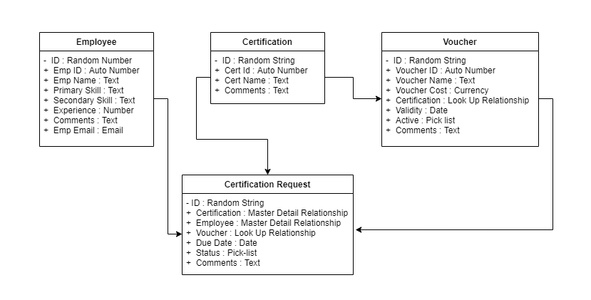

Slide 5
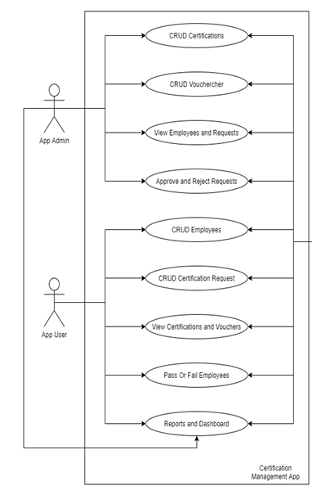
TYPES OF USERS:
App Admin
App User

Slide 6
APPLICATION FLOW

Slide 7
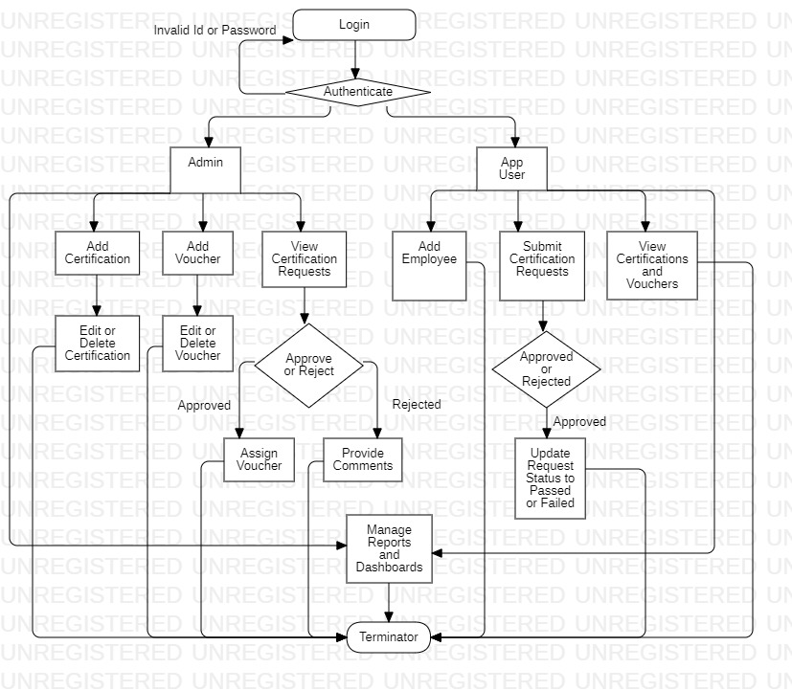

Slide 8
Reports And Dashboard

Slide 9
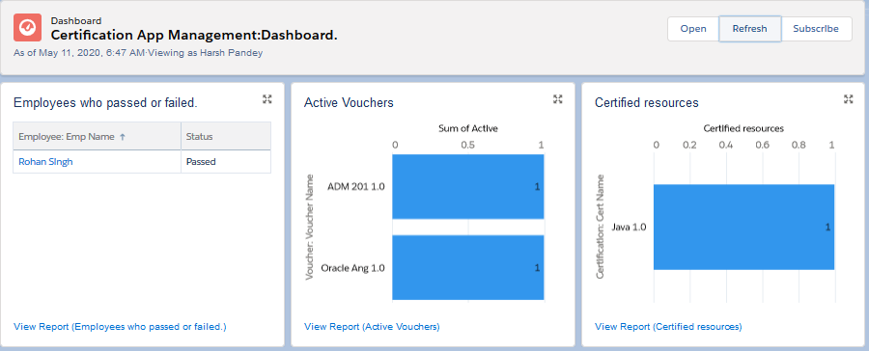

Slide 10
VALIDATIONS

Slide 11
App User should not be able to raise same certification voucher request again if one already exist in the system.
App User should not be able to add new certification voucher request in system if there is any pending request exist for that employee.
Voucher Name must be unique and 10 chars long.
Voucher Validity should be greater than today (the date is stored in the database).
Request Due date should not be less than Today (the date is stored in the database).
A Voucher should be Active for it to be applied.
If a request has been approved and has no voucher, but a voucher is available, then it should be automatically applied.
If an employee gets passed/failed in any certification then system should not allow to App User to raise same certification request for that employee again

Slide 12
THANK YOU

